Slide 1
Machine Learning
Presented By:
Shaishab Joshi
Sonika Bohora
Minisha Dangol
Raj Gurung
Siddhartha Shakya
Richina Pradhan

Slide 2
CONTENTS
01
04
What is Machine Learning?
Semi-Supervised Learning
Definition, history & key concepts
Combining labeled and unlabeled data
02
05
Supervised Learning
Reinforcement Learning
Regression & Classification with examples
Agent-based learning through rewards
03
06
Unsupervised Learning
Statistical-Based Learning
Clustering, Dimensionality Reduction, Anomaly Detection & Association Rules
Naive Bayes model with example

Slide 3
What is Machine Learning?
Definition
ML in the AI Ecosystem
Machine Learning (ML) is a subset of Artificial Intelligence that enables systems to learn and improve from experience automatically — without being explicitly programmed.
Artificial Intelligence
Machine Learning
Arthur Samuel (1959):
Deep
Learning
"The field of study that gives computers the ability to learn without being explicitly programmed."
Key Characteristics
Learns from data patterns
Improves with experience
Makes predictions or decisions
Adapts without explicit rules

Slide 4
Types of Machine Learning
A high-level overview of the major learning paradigms
📊
🔍
⚖️
🎮
Supervised
Learning
Unsupervised
Learning
Semi-
Supervised
Reinforcement
Learning
Trains on labeled data with input-output pairs
Finds hidden patterns in unlabeled data
Combines small labeled data with large unlabeled data
Agent learns through rewards & penalties
e.g. Spam detection, Price prediction
e.g. Customer segmentation, Anomaly detection
e.g. Image classification, Text analysis
e.g. Game AI, Robot navigation, Trading bots

Slide 5
Supervised Learning
The algorithm learns from a labeled training dataset, where each data has an input and a known correct output.
📈 REGRESSION
🏷️ CLASSIFICATION
Predicts a continuous numerical value.
Output: a number on a continuous scale.
Predicts a discrete category or class label.
Output: one of several predefined classes.
Key Algorithms:
Key Algorithms:
Linear Regression · Polynomial Regression · SVR · Ridge / Lasso
Logistic Regression · Decision Trees · SVM · KNN
Example: Predicting house prices based on size, location, bedrooms
Example: Classifying email as Spam or Not Spam

Slide 6
Regression Example: House Price Prediction
How it Works
Linear Regression — House Price vs. Size
1. Collect training data (size → price)
500
Best Fit Line
2. Fit a line: Price = m×Size + b
400
3. Minimize prediction error (MSE)
300
Price ($K)
4. Use learned model for new houses
200
100
1000
1500
2000
2500
3000
House Size (sqft)

Slide 7
Classification Example: Email Spam Detection
Classification Flow Diagram
Spam Detection Features
📧 Incoming Email
Feature
Spam
Normal
🔗 Suspicious links
High
Low
💰 Money keywords (FREE!)
High
Rare
⚙️ Feature Extraction
(word freq, links, sender)
👤 Unknown sender
Yes
No
📎 Unexpected attachments
Common
Rare
🧠 Classification Model
(Logistic Regression / SVM)
📢 ALL CAPS text
Frequent
Rare
Outcome
The model outputs SPAM or NOT SPAM — a binary classification. Multi-class variants can categorize as Promotions, Social, Updates, etc.
🚫 SPAM
✅ NOT SPAM

Slide 8
Unsupervised Learning
Finding hidden patterns in data with NO labels
⬡ Clustering
⬇️ Dimensionality
Reduction
Groups similar data points together based on inherent similarity.
Reduces the number of features while preserving important information.
Algorithms: K-Means, DBSCAN, Hierarchical, GMM
Algorithms: PCA, t-SNE, LDA, Autoencoders
🚨 Anomaly
Detection
🔗 Association
Rule Learning
Identifies data points that deviate significantly from normal patterns.
Discovers interesting relationships and co-occurrence rules in large datasets.
Algorithms: Isolation Forest, One-Class SVM, LOF
Algorithms: Apriori, FP-Growth, Eclat

Slide 9
Clustering: Customer Segmentation (K-Means)
K-Means Algorithm
Customer Segmentation Clusters
1
Choose K clusters
Select K=3 (Budget, Mid, Premium)
✕
2
Initialize centroids
Randomly place 3 center points
3
Assign points
Each customer → nearest centroid
Annual Spend ($K)
✕
4
Update centroids
Recalculate center of each cluster
5
Repeat until converged
Stop when clusters don't change
✕
Result: 3 customer segments for targeted marketing campaigns
Annual Income ($K)
Budget
Mid
Premium

Slide 10
Dimensionality Reduction & Anomaly Detection
⬇ Dimensionality Reduction
🚨 Anomaly Detection
Compresses high-dimensional data into fewer features while retaining maximum information and structure.
Identifies rare items, events or observations that raise suspicion by differing significantly from the majority.
PCA — Projecting 3D → 2D
Network Traffic Anomaly Detection
3D Space
(x, y, z)
2D Space
(PC1, PC2)
!
●
●
●
PCA
●
●
●
●
●
●
●
●
●
!
!
Use Cases: Image compression, Visualizing high-dim data, Noise reduction, Feature engineering for ML pipelines
Normal
Anomaly
Use Cases: Fraud detection, Intrusion detection, Industrial fault detection, Medical diagnostics
Algorithms: PCA · t-SNE · UMAP · LDA · Autoencoders
Algorithms: Isolation Forest · One-Class SVM · LOF · Autoencoders

Slide 11
Association Rule Learning
Discovers interesting relationships between variables in large databases — the classic example: Market Basket Analysis.
Market Basket Analysis Example
🛒 {Bread, Butter}
🥛 {Milk}
Example: 75% of customers who buy Bread & Butter also buy Milk.
IF...THEN

Slide 12
Semi-Supervised Learning
Unsupervised
(No labels)
⚖️ SEMI-
SUPERVISED
Supervised
(All labeled)
How it Works
Real-World Examples
📂
Start with small labeled dataset
🌐 Web Content Classification
Only a tiny fraction of data has labels (expensive to obtain)
Few manually tagged pages + billions of unlabeled web pages
🗂️
Large unlabeled dataset available
🏥 Medical Image Analysis
Vast amounts of raw, unlabeled data are cheap to collect
Few expert-labeled X-rays + large pools of unlabeled scans
🔄
Pseudo-labeling
Train on labeled data, predict labels for unlabeled samples
💬 Speech Recognition
Small transcribed speech + massive unlabeled audio corpora
📈
Iterative training
Add high-confidence pseudo-labels back to training set and repeat
📸 Photo Tagging
Google Photos uses few labeled images to tag millions more

Slide 13
Reinforcement Learning
The RL Feedback Loop
Applications
🤖 AGENT
🎮
Game Playing
AlphaGo, OpenAI Five — agents beat world champions
🤖
Robotics
Teaching robots to walk, grasp objects, navigate spaces
Reward
+ State
Action
📈
Algorithmic Trading
Optimize buy/sell decisions to maximize portfolio returns
🌍 ENVIRONMENT
🚗
Self-Driving Cars
Lane keeping, speed control, collision avoidance systems
Key Components
💊
Healthcare
Policy (π)
Reward (R)
Value Fn (V)
Personalized treatment planning and drug dosage optimization
Strategy the agent uses
Feedback signal
Expected future reward

Slide 14
Statistical-Based Learning: Naive Bayes
Bayes' Theorem
P(Class | Features) = P(Features | Class) × P(Class) / P(Features)
Posterior
P(C|F)
Likelihood
P(F|C)
Prior
P(C)
Probability the email is Spam GIVEN the words we see. This is what we want!
How likely are we to see these words IF the email is Spam?
What fraction of all emails are Spam before seeing any words?
🔑 The 'Naive' Assumption
All features are assumed to be conditionally independent given the class. Even though this is often not true in reality, Naive Bayes still works surprisingly well!
Variants:
Gaussian NB — continuous features
Multinomial NB — text classification
Bernoulli NB — binary features
Complement NB — imbalanced datasets

Slide 15
Naive Bayes Example: Email Spam Classification
Step 1 — Training Data
Step 2 — Classifying New Email
Email Words
Label
📧 New Email: 'FREE money offer'
FREE money offer click
SPAM
Calculate P(word | class) for each word:
Win prize lottery click
SPAM
Word
P(word|SPAM)
P(word|NSPAM)
Meeting tomorrow agenda
NSPAM
FREE
2/3
0/3
Hello project update team
NSPAM
money
1/3
0/3
FREE offer win lottery
SPAM
offer
1/3
0/3
Team lunch project plan
NSPAM
Apply Bayes' Theorem:
P(Spam|Email) ∝ 0.5 × (2/3) × (1/3) × (1/3) = 0.037
Prior Probabilities
P(NSPAM) = 3/6
= 0.50
P(NSPAM) = 3/6
= 0.50
P(NSpam|Email) ∝ 0.5 × (0/3) × (0/3) × (0/3) ≈ 0.000
✅ VERDICT: Email classified as SPAM

Slide 16
Key Takeaways
📊
Supervised Learning uses labeled data for prediction and classification tasks.
🔍
Unsupervised Learning discovers hidden structures without any labels.
⚖️
Semi-Supervised bridges both worlds — great when labels are scarce and expensive.
🎮
Reinforcement Learning trains agents through reward-penalty feedback loops.
📐
Naive Bayes applies Bayes' theorem with strong independence assumptions.

Slide 17
GENETIC
ALGORITHM
Nature-inspired optimization through evolution, selection & genetics
01101001 10110010 11001011 01010110

Slide 18
Introduction to Genetic Algorithm
Genetic Algorithm (GA) is a search and optimization technique inspired by Charles Darwin's theory of natural selection. It mimics biological evolution to find optimal or near-optimal solutions for complex problems.
Inspired by Nature
Population-based
Iterative Process
Evolution, survival of the fittest, natural selection form the basis of GA.
Works on a population of candidate solutions rather than a single solution.
Progressively evolves solutions through repeated generations toward the optimal.
WHERE IT'S USED:
Scheduling
Engineering Design
Machine Learning
Route Optimization
Game AI

Slide 19
Basic Terminology in Genetic Algorithm
🧬 Gene
🔗 Chromosome
The basic unit of information — a single variable or bit in a chromosome.
A string of genes representing one complete solution/individual.
👥 Population
🔄 Generation
A set of chromosomes (candidate solutions) evaluated in each generation.
One full cycle of selection, crossover, and mutation over the population.
⭐ Fitness
A score measuring how good a chromosome is — higher fitness = better solution.

Slide 20
Phases of Genetic Algorithm
01
Initialization Generate initial random population of chromosomes
🔁 Evolution Loop
The algorithm repeats phases 2-6 until:
• A target fitness is reached
• Max generations hit
• No improvement observed
02
Fitness Evaluation Evaluate each chromosome using the fitness function
03
Selection Select fit parents for reproduction
04
Crossover Combine parent chromosomes to produce offspring
⚡ Key Operators: Selection · Crossover · Mutation
05
Mutation Randomly alter genes to maintain diversity
06
Replacement Replace old population with new generation

Slide 21
Genetic Operators
Genetic Operators are mechanisms that transform the population from one generation to the next, mimicking biological processes.
🎯 Selection
Choose the fittest individuals from the current population to act as parents for the next generation.
✂️ Crossover
Combine genetic material from two (or more) parents to produce new offspring.
⚡ Mutation
Randomly alter genes in an offspring to introduce new genetic diversity and avoid local optima.

Slide 22
Selection — Parent Selection
Selection is the process of choosing parent chromosomes from the current population to breed the next generation. Chromosomes with higher fitness have a higher probability of being selected.
SELECTION TECHNIQUES COVERED:
01
Fitness Proportionate (Roulette Wheel)
02
Tournament Selection
03
Rank Selection
Sample Population Fitness Values:
C1
C2
C3
C4
C5
C6

Slide 23
🎯 Fitness Proportionate Selection (Roulette Wheel)
Definition: Each chromosome is assigned a selection probability proportional to its fitness value. Chromosomes with higher fitness have a greater chance of being selected — like a spinning roulette wheel where larger slices = more fit individuals.
Formula: P(i) = f(i) / Σf(j) where f(i) = fitness of chromosome i
EXAMPLE:
Chromosome | Fitness | % of Total (P) | Cumulative P
C1 | 28 | 28/115 = 24.3% | 24.3%
C2 | 17 | 17/115 = 14.8% | 39.1%
C3 | 35 | 35/115 = 30.4% | 69.5%
C4 | 22 | 22/115 = 19.1% | 88.6%
C5 | 13 | 13/115 = 11.4% | 100%
✅ C3 has the highest fitness (35) → largest slice → most likely selected (30.4% chance)

Slide 24
🏆 Tournament Selection
Definition: A fixed number (k) of chromosomes are randomly picked from the population to compete in a "tournament". The chromosome with the highest fitness among the group wins and is selected as a parent. This process is repeated until enough parents are selected.
EXAMPLE (Tournament Size k = 3):
C1
C2
C3
C4
C5
C6
f = 28
f = 17
f = 35
f = 22
f = 13
f = 40
PICKED
PICKED
PICKED
Tournament Round:
C2 (f=17) vs C4 (f=22) vs C6 (f=40)
🏆 Winner: C6 (f=40) → Selected as parent!
✅ Advantage: Works well even when fitness values vary widely. No need to compute selection probabilities.

Slide 25
📊 Rank Selection
Definition: Instead of using raw fitness values, chromosomes are ranked from worst (rank 1) to best (rank N). Selection probability is then assigned based on rank, not fitness value. This prevents dominance by a few very fit individuals.
EXAMPLE:
Chromosome | Fitness | Rank | Selection P
C5 | 13 | 1 (worst) | 1/15 = 6.7%
C2 | 17 | 2 | 2/15 = 13.3%
C4 | 22 | 3 | 3/15 = 20.0%
C1 | 28 | 4 | 4/15 = 26.7%
C3 | 35 | 5 (best) | 5/15 = 33.3%
Total rank sum = 1+2+3+4+5 = 15. C3 (best) gets rank 5 → P = 5/15 = 33.3%
✅ Advantage: Prevents premature convergence by giving even weak chromosomes a non-zero selection chance.

Slide 26
✂️ Crossover (Recombination)
Crossover is the genetic operator that combines genetic material from two (or more) selected parents to produce new offspring. It is the primary mechanism for exploration in a genetic algorithm — analogous to biological reproduction.
SIMPLE EXAMPLE (One-Point Crossover at position 4):
TYPES COVERED NEXT:
1
0
1
1
crossover
point
One-Point
Parent 1
|
0
0
1
Parent 2
0
1
0
0
|
1
1
0
Two-Point
Uniform
⬇ Offspring
Three-Parent
Child 1
1
0
1
1
1
1
0
Shuffle
Child 2
0
1
0
0
0
0
1

Slide 27
One-Point Crossover
Definition: A single crossover point is selected on the parent chromosomes. Genes before the point come from Parent 1; genes after the point come from Parent 2 (and vice versa for Child 2).
EXAMPLE — Crossover Point after gene 3:
1
2
3
|
4
5
6
7
8
Parent 1
1
0
1
1
0
0
1
0
Parent 2
0
1
1
0
1
0
0
1
↑ Point 3
↓ Children:
Child 1
1
0
1
0
1
0
0
1
← P1 genes 1-3 + P2 genes 4-8
Child 2
0
1
1
1
0
0
1
0
← P2 genes 1-3 + P1 genes 4-8

Slide 28
Two-Point Crossover
Definition: Two crossover points are selected. The segment between the two points is swapped between the two parents to produce offspring. This preserves more of the original parent structure at both ends.
EXAMPLE — Crossover Points after genes 2 and 5:
1
2
|
3
4
5
|
6
7
8
Parent 1
1
0
1
1
0
0
1
0
Parent 2
0
1
1
0
1
0
0
1
↑ Pt 1
↑ Pt 2
↓ Children (middle segment swapped):
Child 1
1
0
1
0
1
0
1
0
P1[1-2] + P2[3-5] + P1[6-8]
Child 2
0
1
1
1
0
0
0
1
P2[1-2] + P1[3-5] + P2[6-8]

Slide 29
Uniform Crossover
Definition: No crossover points — instead, each gene is independently inherited from either parent with equal probability (typically 50%). A random mask determines which parent contributes each gene.
EXAMPLE — Random Mask: [P1, P2, P1, P2, P1, P1, P2, P2]:
Parent 1
1
0
1
1
0
0
1
0
Parent 2
0
1
0
0
1
1
0
1
Mask
P1
P2
P1
P2
P1
P1
P2
P2
↓ Child 1 (take gene from indicated parent):
Child 1
1
1
1
0
0
0
0
1
pos 1,3,5,6 from P1 · pos 2,4,7,8 from P2 → highly varied offspring!

Slide 30
Three-Parent Crossover
Definition: Three parent chromosomes participate. For each gene position, if the gene from Parent 1 equals the gene from Parent 2, the child inherits that gene; otherwise, the child inherits the gene from Parent 3. Only one child is produced.
RULE: Child[i] = P1[i] if P1[i] == P2[i], else P3[i]
Parent 1
1
0
1
1
0
0
1
0
Parent 2
1
1
1
0
0
1
0
0
Parent 3
0
1
0
1
1
0
1
1
Match?
YES
NO
YES
NO
YES
NO
NO
YES
↓ Child:
Child
1
1
1
1
0
0
1
0
Green = from P1≡P2 agreement · White = from P3

Slide 31
Shuffle Crossover
Definition: Before crossover, the genes of both parents are randomly shuffled (permuted) together at corresponding positions. Then a standard one-point crossover is applied. After producing offspring, the genes are unshuffled back to their original positions. This reduces positional bias.
EXAMPLE — Shuffle order: [3,1,4,2,7,5,8,6]:
P1 original
1
0
1
1
0
0
1
0
P2 original
0
1
1
0
1
1
0
1
P1 shuffled
1
1
1
0
1
0
0
0
P2 shuffled
1
0
0
1
0
1
1
1
↑ cut pt 3
Child shuffled
1
1
1
1
0
1
1
1
Child (final)
1
1
1
1
1
1
0
1
✅ Reduces positional bias — every gene has an equal chance to be at each crossover segment.

Slide 32
⚡ Mutation
Mutation is a genetic operator that randomly alters one or more genes in a chromosome with a small probability (mutation rate μ, typically 0.001–0.01). It introduces new genetic material to maintain diversity and prevent premature convergence to a local optimum.
EXAMPLE — Bit Flip Mutation at gene position 5:
Before
1
0
1
1
0
0
1
0
⚡ flipped!
0→1
After
1
0
1
1
0
1
1
0
COMMON MUTATION TYPES:
Bit Flip: Flip a bit 0→1 or 1→0 at a random position (binary encoding).
Swap: Randomly select two gene positions and swap their values.
Scramble: Select a random subset of genes and shuffle their order.
Inversion: Reverse the order of genes between two randomly chosen positions.

Slide 33
⭐ Fitness Function
Fitness Function is the evaluation function that measures how well each chromosome (solution) solves the problem. It assigns a numerical score — the "fitness" — to each individual. The GA uses this score to guide selection: higher fitness = better solution = higher chance of being selected.
EXAMPLE — Maximizing f(x) = x² where x is encoded as a 4-bit binary:
Chromosome (bits) | Decimal (x) | Fitness f(x)=x² | Rank
0101 | 5 | 25 | 3
1011 | 11 | 121 | 2
0011 | 3 | 9 | 4
1110 | 14 | 196 | 1 🏆
🏆 Best: [1110] → x=14 → f(14) = 196 — Highest fitness, most likely selected for reproduction!
KEY PROPERTIES:
▸ Problem-specific — must be carefully designed
▸ Computationally inexpensive (called every generation)
▸ Continuous and differentiable helps, but not required

Slide 34
⭐ Conclusion
Genetic Algorithms mimic the process of natural evolution to intelligently explore and optimize solutions, continuously refining them over generations by evolving better answers instead of directly computing a single result.

Slide 35
MACHINE LEARNING
Learning with
Neural Networks

Slide 36
TODAY'S AGENDA
01
03
Introduction
Mathematical Model
What are neural networks? Why do they matter?
Weights, biases, activation functions, and learning
02
Biological vs Artificial
How the brain inspired AI — from neurons to nodes

Slide 37
01
Introduction to Neural Networks
Neural Network: A computing system inspired by biological neural networks in animal brains — it learns from examples to perform tasks without explicit programming.
🧠
Inspired by Biology
📚
Learns from Data
Modeled after the human brain's structure of connected neurons
Improves its performance through training on examples
🔗
Interconnected Layers
⚡
Pattern Recognition
Input → Hidden → Output layers process information
Excels at finding complex patterns in images, text & numbers
1943 — McCulloch-Pitts neuron
1958 — Perceptron invented
2012 — Deep Learning revolution
Today — Powers ChatGPT, self-driving cars & more

Slide 38
What IS a Neural Network?
Imagine Your Brain as a Team! 🏆
How a Kid Learns:
Think of your brain as a HUGE team of tiny players called neurons. Each player: 👀 Sees information
🤔 Thinks about it a little
📣 Passes it to the next player
When you see a cat 🐱: → Eyes see pointy ears, whiskers, fur
→ Brain neurons fire up & connect
→ You say "That's a cat!"
A computer neural network does the SAME thing — but with math instead of a real brain!
👶
Baby sees many dogs
✅
Mom says "That's a dog!"
❌
"No, that's a cat!"
🧠
Brain updates & learns
🎉
Now recognizes dogs!
🌟 This is EXACTLY how neural networks are trained with data!

Slide 39
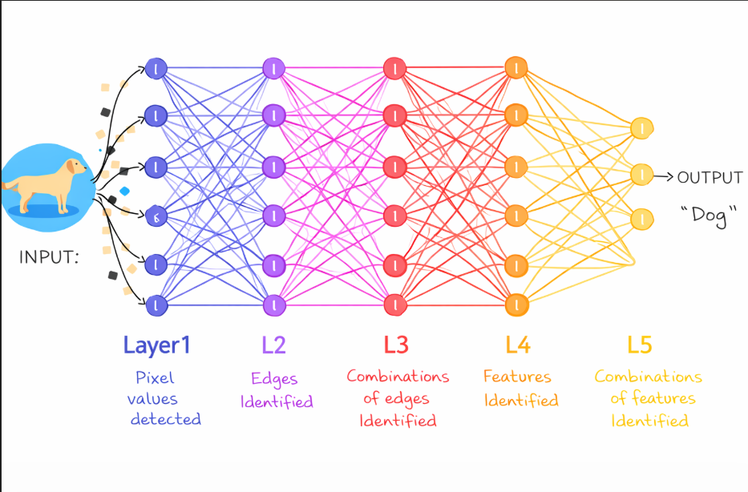

Slide 40
02
Biological Neural Network
Parts of a Biological Neuron 🧠
How It Works:
Dendrites
1
Signal arrives at dendrites
Branch-like extensions that RECEIVE signals from other neurons — like antennae picking up information
2
Soma integrates all inputs
Cell Body (Soma)
The neuron's headquarters — processes all incoming signals and decides whether to fire
3
If threshold is met → fires!
Axon
Long fiber that TRANSMITS the signal to the next neuron — like a cable sending data
4
Signal travels down axon
Synapse
5
Crosses synapse to next neuron
The tiny gap between neurons where signals jump across using chemicals (neurotransmitters)
⚡ 86 billion neurons in the human brain!

Slide 41
Artificial Neural Network (ANN) — Structure
INPUT LAYER
HIDDEN LAYERS
OUTPUT LAYER
Receives raw data
(pixels, numbers, text)
Learns features &
patterns from data
Produces final
prediction/result
💡 Each connection has a WEIGHT that determines how strongly one neuron influences another — this is where learning happens!

Slide 42
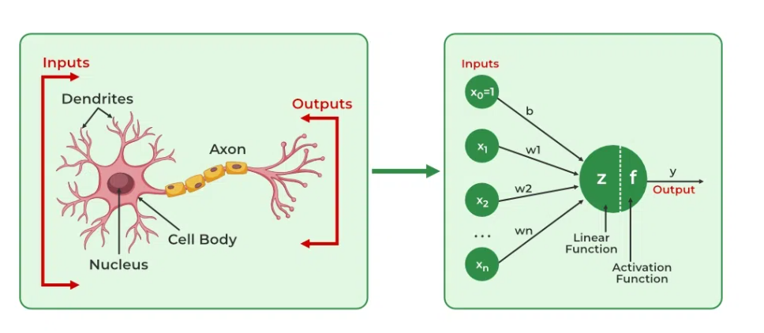

Slide 43
🧠 Biological vs 🤖 Artificial Neural Networks
Feature
🧠 Biological
🤖 Artificial
Basic Unit
Neuron
Artificial Node / Perceptron
Connections
Synapses (~7000/neuron)
Weighted Edges
Speed
~200 signals/sec
Millions of ops/sec (GPU)
Learning
Synaptic plasticity
Backpropagation + Gradient Descent
Memory
Distributed across neurons
Stored in weights & biases
Power
~20 watts
100s of watts to megawatts
Fault Tolerant
Yes — adapts to damage
Partially — distributed weights
Key Insight: ANNs are a simplified mathematical abstraction of biological neural networks — not a perfect replica!

Slide 44
03 Mathematical Model of ANN
Core Equation:
Output = f( w₁x₁ + w₂x₂ + ... + wₙxₙ + b )
xᵢ
Inputs
wᵢ
Weights
The data fed into the neuron (e.g., pixel values, sensor readings, numbers)
How important each input is — learned during training. High weight = strong influence
b
Bias
f()
Activation
A constant that helps the model shift its decision boundary — adds flexibility
A function that decides if/how strongly the neuron fires (sigmoid, ReLU, tanh…)

Slide 45
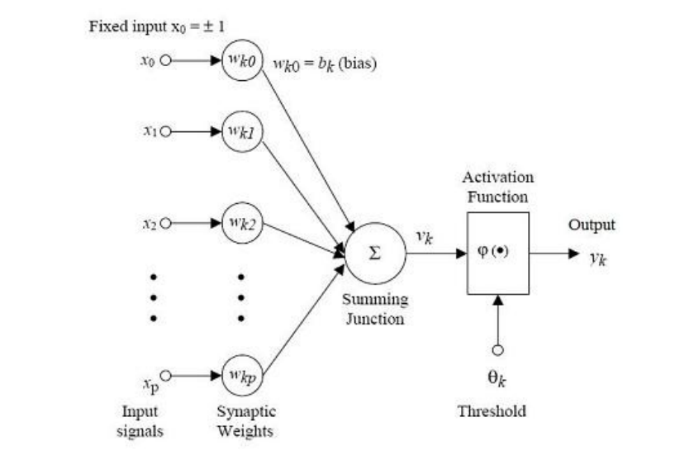

Slide 46
Understanding Weights with a Story!
🎂 The Birthday Cake Decider!
The Math in Real Life:
Imagine you're deciding if Mom will bake a birthday cake. The INPUTS are clues: 🎂 Is it your birthday? (x₁ = 1 if Yes, 0 if No) 😊 Is Mom in a good mood? (x₂ = 1 if Yes, 0 if No) 🛒 Are there ingredients? (x₃ = 1 if Yes, 0 if No) The WEIGHTS show importance: Birthday? = 5 (very important!) Good mood? = 3 (quite important) Ingredients? = 4 (very important!) SUM = (1×5) + (1×3) + (1×4) = 12 If SUM > 7 → 🎂 YES, bake a cake! If SUM ≤ 7 → ❌ No cake today...
Story
ANN Math
Cake Inputs
x₁, x₂, x₃ (Input values)
Importance
w₁, w₂, w₃ (Weights)
"How sure am I?"
b (Bias)
Counting up clues
Σ(wᵢxᵢ) + b
"Bake or not?"
f() Activation fn
Learning from Mom
Backpropagation

Slide 47
Key Takeaways 🎯
🧠
Neural Networks are inspired by the human brain — layers of connected nodes that process information
⚖️
Weights & Biases are the adjustable parameters that make learning possible — they define what the network knows
⚡
Activation functions introduce non-linearity, allowing ANNs to learn complex, real-world patterns
🔄
Training uses Forward Pass + Loss Calculation + Backpropagation + Weight Updates in a continuous cycle
🌍
Neural Networks power everyday AI — from your phone's face unlock to medical diagnoses and language translation

Slide 48
01
SECTION
Activation
Functions
Mathematical operations applied to neural signal outputs

Slide 49
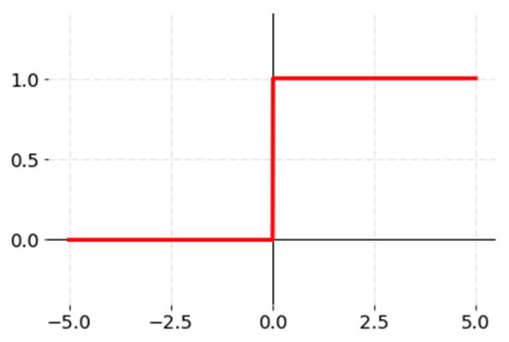
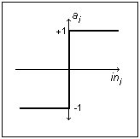
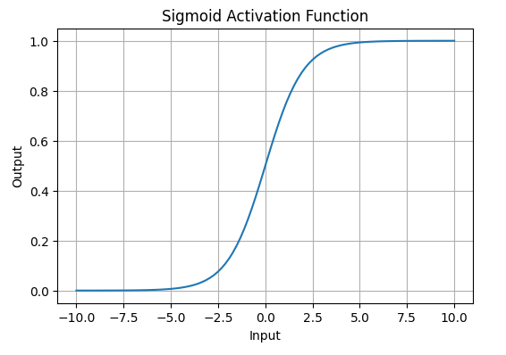
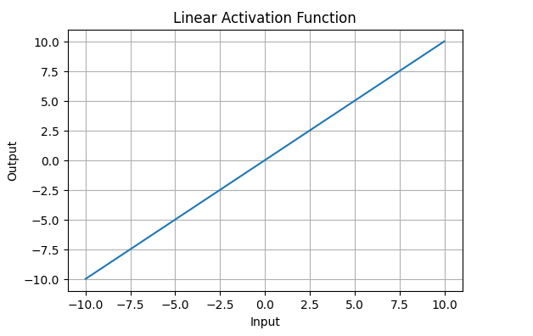
What is an Activation Function?
An activation function f performs a mathematical operation on the signal output of a neuron, determining whether and how strongly it fires.
Notation: Vₖ = X (input) | Yₖ = Y (output)
Step Function
Sign Function
Sigmoid Function
Linear Function
📈
📈
Y = 1, if X ≥ 0
Y = 0, if X < 0
Y = +1, if X ≥ 0
Y = -1, if X < 0
Y = 1 / (1 + e⁻ˣ)
Y = X

Slide 50
Activation Functions — Details & Comparison
Step Function
Binary output — fires or doesn't. Useful for simple threshold decisions but non-differentiable at 0.
Use: Binary classifiers
Y = 1 if X ≥ 0, else Y = 0
Sign Function
Similar to step but outputs −1/+1 instead of 0/1. Good for bipolar data representations.
Use: Bipolar classifiers
Y = +1 if X ≥ 0, else Y = −1
Sigmoid Function
Smooth, differentiable S-shaped curve. Outputs between 0 and 1. Widely used in hidden layers.
Use: Hidden layers, probabilities
Y = 1 / (1 + e⁻ˣ)
Linear Function
Direct pass-through. Output equals input. Simple but cannot model non-linear relationships.
Use: Regression output layers
Y = X

Slide 51
02
SECTION
Types of ANN
Feed-forward Networks • Recurrent Networks
Single Layer • Multi-Layer

Slide 52
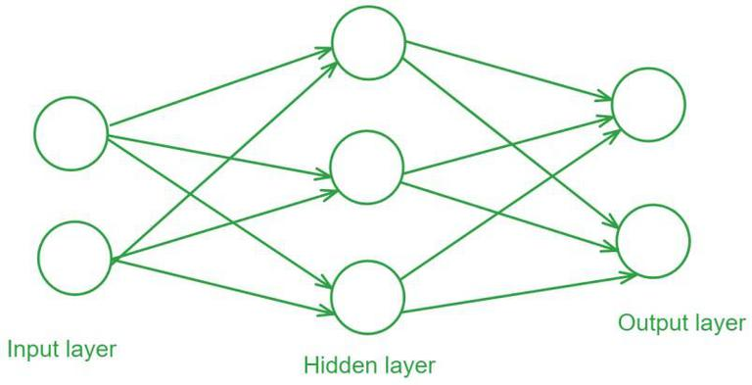
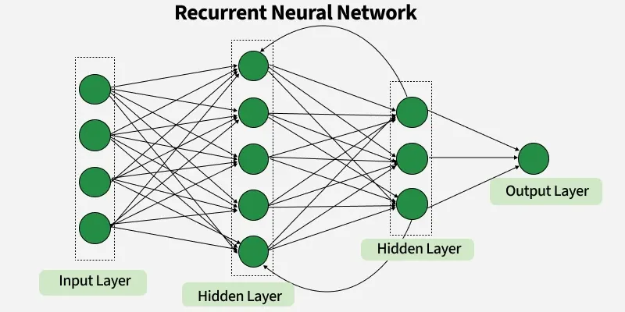
Types of ANN: Feed-forward vs Recurrent
Feed-Forward Neural Network
Recurrent Neural Network (RNN)
Information flows in ONE direction only
Input → Hidden Layers → Output
No loops or feedback connections
Lacks memory — processes only current input
Best for static pattern recognition tasks
Information undergoes a CYCLICAL process
Contains feedback loops — output re-enters
Considers current input + past memory
Incorporates knowledge from previous steps
Exhibits a form of memory for sequences
Direction: Input → Output (linear)
Direction: Loop (cyclical with feedback)

Slide 53
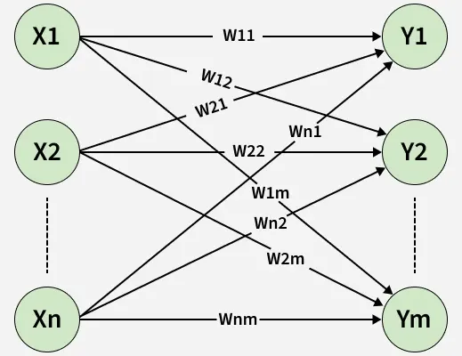
Single Layer Feed-forward Network
Key Characteristics
x1
y1
n input neurons (x₁ to xₙ)
m output (single-layer) neurons
Each input connects to every output via weights wᵢⱼ
No hidden layers — direct input to output
Simplest form of feed-forward network
Suitable for linearly separable problems
x2
wᵢⱼ
y2
x3
yₘ
xₙ
Input
Neurons (xᵢ)
Weights
(wᵢⱼ)
Single Layer
Neurons (yⱼ)

Slide 54
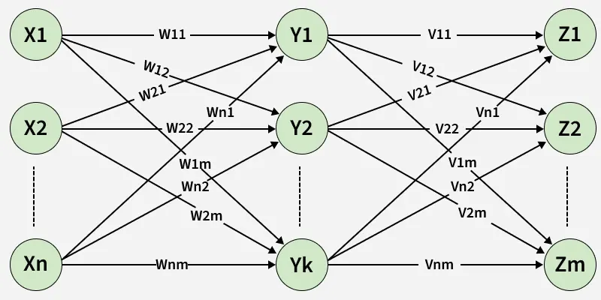
Multi-Layer Feed-forward Network (ℓ – m – n Configuration)
Architecture Details
Input Layer (ℓ)
Receives raw input features; neurons xᵢ pass data forward
Hidden Layer (m)
Intermediate processing; weights Vᵢⱼ connect input to hidden neurons yⱼ
Output Layer (n)
Final result; weights Wⱼₖ connect hidden to output neurons zₖ
More layers = greater capacity for non-linear learning

Slide 55
03
SECTION
Applications of
Neural Networks
7 Real-World Domains Where Neural Networks Excel

Slide 56
Neural Network Applications (Part 1)
1
Financial Modeling
2
Time Series Prediction
Predicting the Stock Market
Climate, Weather & Seizures
Stock Price Prediction: Analyze historical prices, market indicators & financial data using RNNs / LSTM networks
Algorithmic Trading: Make trading decisions based on predicted price movements, executing trades automatically
Climate & Weather Forecasting: Predict future patterns by analyzing historical weather data and satellite images
Seizure Prediction: Analyze EEG signals to forecast epileptic seizures for timely medical intervention
3
Computer Games
4
Robotics
Intelligent Agents, Chess, Backgammon
Autonomous Adaptable Robots
Intelligent Agents: Power adaptive game AI that learns from player actions for challenging gameplay
Game Playing: Achieve superhuman performance in chess, backgammon & Go via reinforcement learning
Autonomous Navigation: Navigate complex environments by processing sensor data in real-time
Adaptability: Perform object recognition, manipulation & obstacle avoidance in dynamic environments

Slide 57
Neural Network Applications (Part 2)
5
Pattern Recognition — Speech, Seismic Activity, Sonar Signals
Speech Recognition: Convert spoken language to text by recognizing patterns in audio (virtual assistants, transcription)
Seismic Activity: Detect & predict earthquakes from seismic data, enabling early warnings
Sonar Signal Processing: Detect underwater objects and map the underwater environment
6
Data Analysis — Data Compression & Data Mining
Data Compression: Autoencoders learn efficient representations to reduce storage and transmission requirements
Data Mining: Identify patterns and extract insights from large datasets in marketing, healthcare, and finance
7
Bioinformatics — DNA Sequencing & Alignment
DNA Sequencing: Analyze genetic data to identify sequences, detect mutations, and understand genetic variations
Sequence Alignment: Identify similarities and differences in DNA for studying evolutionary relationships and gene function

Slide 58
Summary
⚡ Activation Functions
🔄 Types of ANN
4 types covered: Step, Sign, Sigmoid, and Linear. Each applies different mathematical transformations to neural signal outputs.
Feed-forward (linear, no memory) vs Recurrent (cyclical, with memory/feedback). Both types detailed with diagrams.
🏗 Network Architectures
🌍 ANN Applications
Single-layer networks (direct input–output) and multi-layer networks (ℓ–m–n configuration with hidden layers) for complex learning.
7 domains: Finance, Time Series, Computer Games, Robotics, Pattern Recognition, Data Analysis, Bioinformatics.

Slide 59

MACHINE LEARNING — UNIT 5
Neural Network
Learning Rules
Department of Computer Science & AI | Academic Lecture Series

Slide 60
Topics at a Glance
01
02
Hebbian Learning
Backpropagation
Unsupervised weight update rule inspired by neuroplasticity — neurons that fire together, wire together.
Supervised multi-layer training algorithm using gradient descent to minimize prediction error.
All three are foundational learning paradigms for training Artificial Neural Networks (ANNs)

Slide 61
01
Hebbian Learning
"Neurons that fire together, wire together" — Donald Hebb, 1949
Unsupervised Learning Algorithm

Slide 62
Hebbian Learning — Core Concept
What is Hebbian Learning?
Hebbian Neuron Model
Developed by Donald Hebb in 1949
An unsupervised weight-update algorithm
Inspired by biological synapse strengthening
“States that the synaptic efficacy between two neurons should increase if the neurons are simultaneously active and decrease if not.”
w1
x₁
x₂
w2
Σ
y
x₃
w3
bias
Hebbian Update Rule
wᵢ(new) = wᵢ(old) + xᵢ · y
b(new) = b(old) + y
xᵢ = input | wᵢ = weight | y = output (= target)

Slide 63
Hebbian Learning — Algorithm
STEP 1
Initialize
STEP 2
Set Inputs
Set all weights wᵢ = 0 for i = 1 to n
Set bias b = 0
For each training pair (S, t):
Activate input units: Xᵢ = Sᵢ for i = 1 to n
STEP 3
Set Output
STEP 4
Update Weights
Set the output neuron's activation to the target value:
y = t
Apply Hebb rule for all i = 1 to n:
wᵢ(new) = wᵢ(old) + xᵢ · y
b(new) = b(old) + y

Slide 64
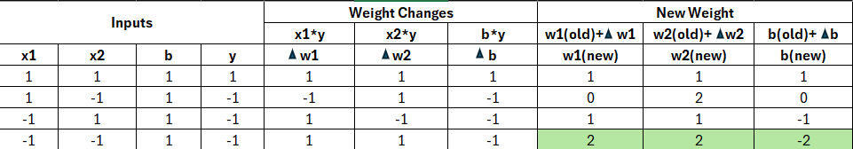
Hebbian Learning — Example: AND Function
Construct a Hebb Net which performs like an AND function. Use bipolar inputs and targets
Final Weights: w₁ = 2, w₂ = 2, b = -2
Y= b + x1 * w1 + x2 * w2
For tp (1,1) : Y= -2+(1*2)+(1*2) = 2 > 0 (So AND gate verified)

Slide 65
02
Backpropagation Learning
"Train multi-layer networks by propagating error backward through layers"
Supervised Learning with Gradient Descent

Slide 66
Backpropagation — Architecture & Concept
Key Concepts
Network Architecture
Trains a multilayer feed-forward neural network
Architecture: Input → Hidden → Output layers
Forward pass: computes predictions layer by layer
Backward pass: propagates error to update all weights
Uses gradient descent with a learning rate (l)
Sigmoid activation: O = 1 / (1 + e⁻ᴵ)
→ FORWARD
← BACKWARD
→ Forward Pass
Compute outputs
Propagate & update weights
Input Layer
Hidden Layer
Output Layer
← Backward Pass

Slide 67
Backpropagation — Key Formulas
FORWARD PASS
BACKWARD PASS
Net input (layer j):
Error — Output layer:
Iⱼ = Σᵢ wᵢⱼ · Oᵢ + θⱼ
Errⱼ = Oⱼ(1 − Oⱼ)(Tⱼ − Oⱼ)
Output (sigmoid):
Error — Hidden layer:
Oⱼ = 1 / (1 + e^(-Iⱼ))
Errⱼ = Oⱼ(1 − Oⱼ) Σₖ Errₖ wⱼₖ
Weight update:
Δwᵢⱼ = l · Errⱼ · Oᵢ → wᵢⱼ += Δwᵢⱼ
Bias update:
Δθⱼ = l · Errⱼ → θⱼ += Δθⱼ

Slide 68
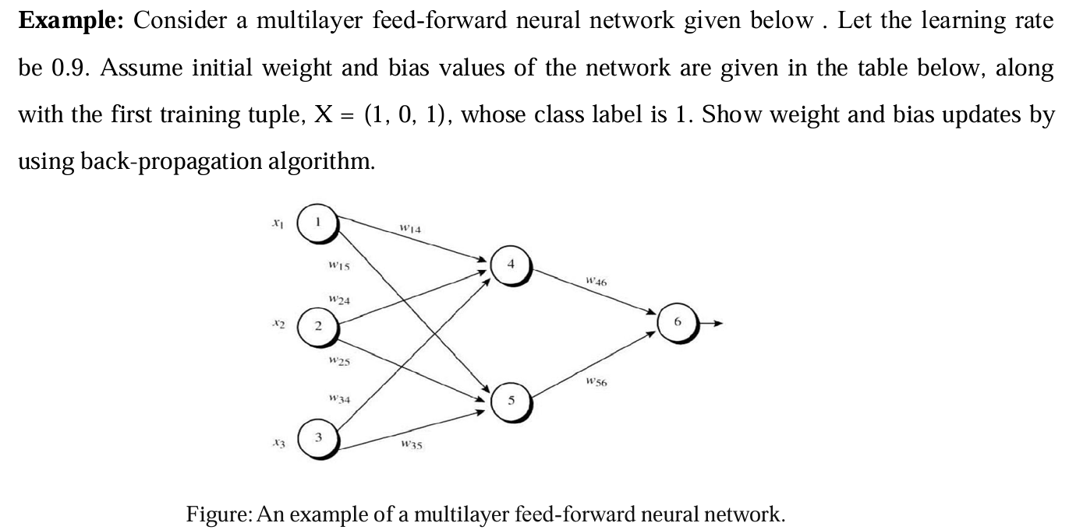
Backpropagation — Example 1

Slide 69
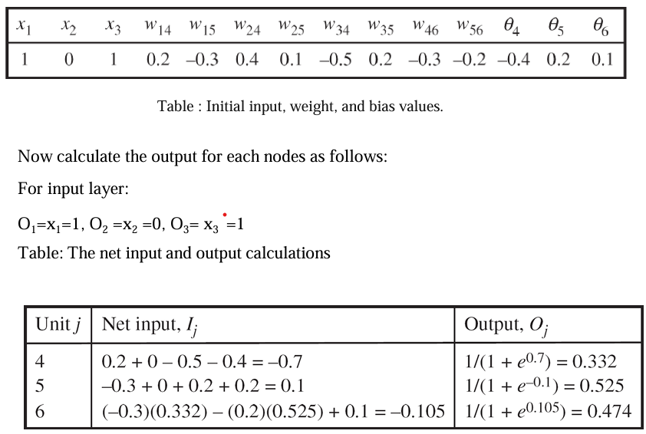
Backpropagation — Worked Example

Slide 70
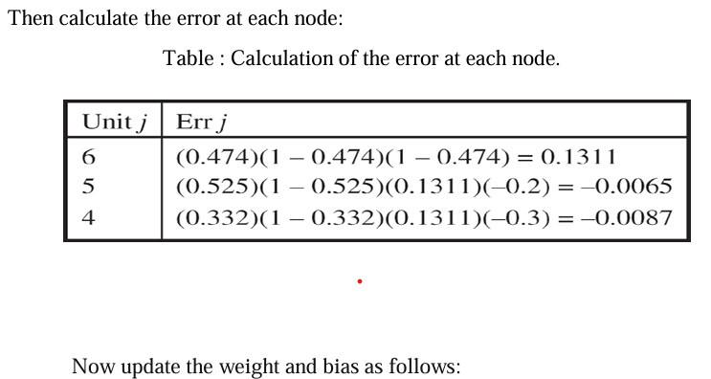
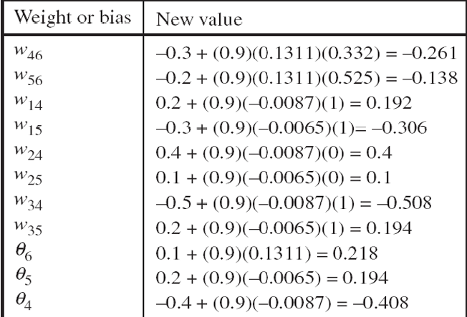
Backpropagation — Worked Example

Slide 71
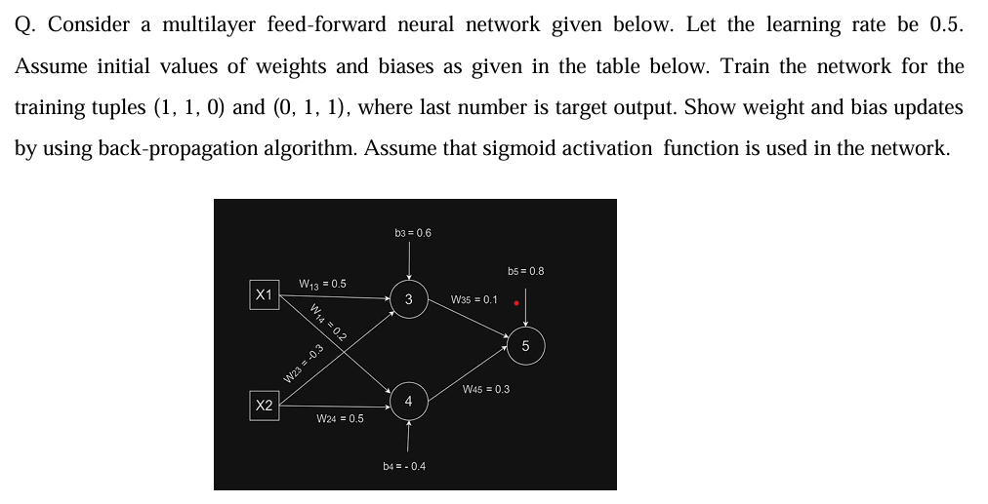
Backpropagation — Example 2

Slide 72
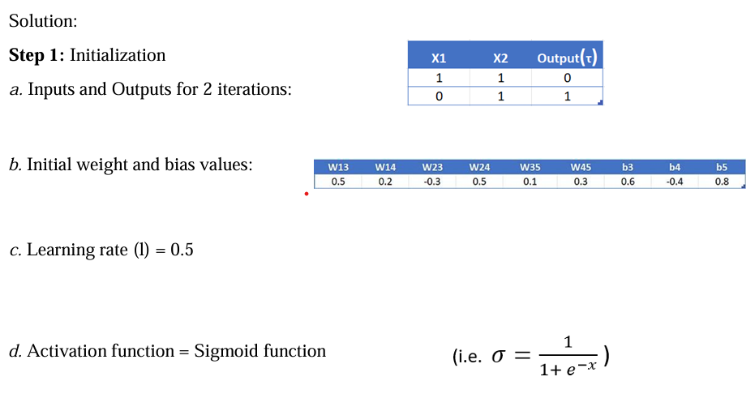
Backpropagation — Worked Example (Step 1)

Slide 73
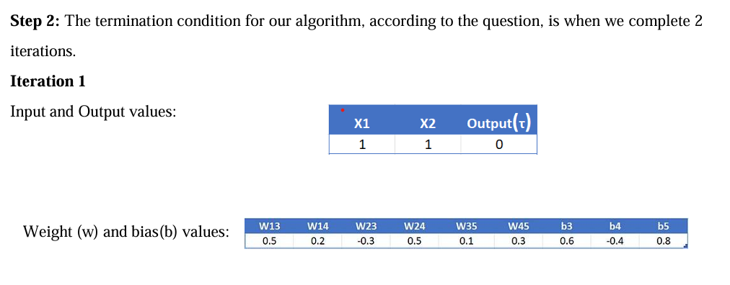
Backpropagation — Worked Example (Step 2)

Slide 74
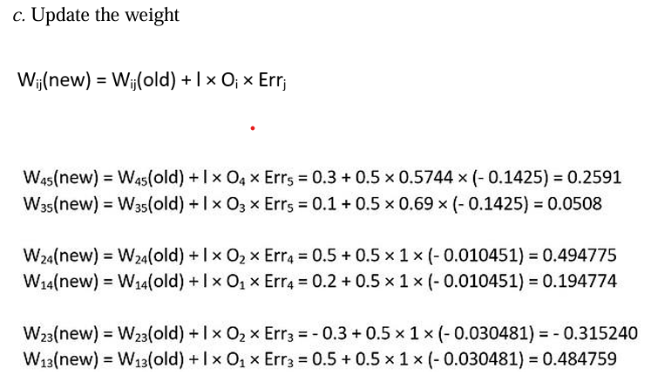
Backpropagation — Worked Example

Slide 75
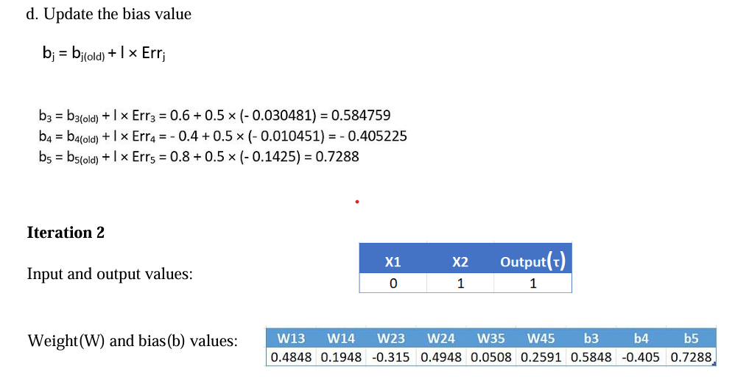
Backpropagation — Worked Example

Slide 76
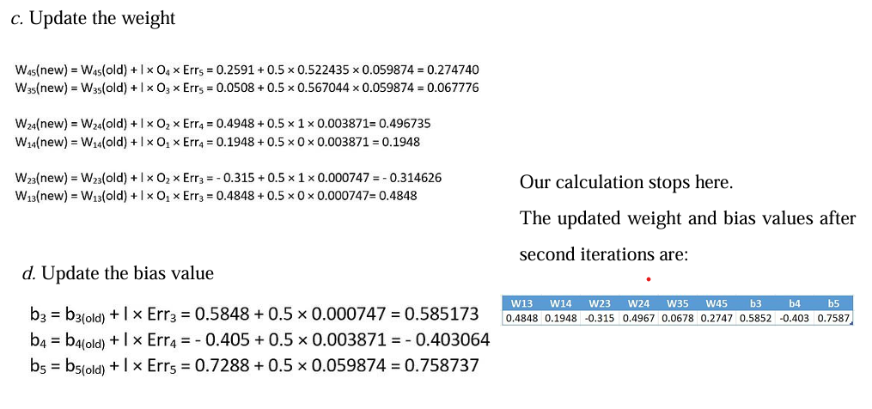
Backpropagation — Worked Example

Slide 77
ARTIFICIAL INTELLIGENCE
Overview of Deep
Learning Architectures
CNN
RNN
GAN
Convolutional
Neural Network
Recurrent
Neural Network
Generative
Adversarial Network
Presented By: Richina Pradhan

Slide 78
What is Deep Learning?
The Foundation — AI → Machine Learning → Deep Learning
Artificial Intelligence
Why Deep Learning?
Broad field — machines simulating human intelligence
Why 'Deep'?
Multiple hidden layers — each learns increasingly complex features. Layer 1: edges. Layer 3: shapes. Layer 5: objects.
▼
Machine Learning
Key Advantage
Systems that learn patterns from data automatically
Automatically learns features from raw data — no manual feature engineering needed.
▼
Requires
Deep Learning ← We are here
Large datasets + powerful GPUs + careful architecture design.
Multi-layered neural networks — our focus today
Powers
Computer vision, NLP, speech recognition, robotics, drug discovery.

Slide 79
Three Major Deep Learning Architectures
Each Designed to Solve a Different Type of Problem
CNN
RNN
GAN
Convolutional Neural Network
Recurrent Neural Network
Generative Adversarial Network
The Eyes of AI
The Memory of AI
The Imagination of AI
Best For:
Images, grids, spatial data
Best For:
Sequences, time series, language
Best For:
Data generation, creative AI
Key Feature:
Convolution + Pooling filters
Key Feature:
Recurrent connections + Hidden state
Key Feature:
Generator vs Discriminator
Used In:
Face recognition, Self-driving cars, Medical imaging
Used In:
Google Translate, Siri, Stock prediction
Used In:
Deepfakes, Image synthesis, Drug discovery
Introduced:
LeNet 1998
Introduced:
1980s / popularized 2014
Introduced:
Goodfellow 2014

Slide 80
PART 1 — CNN
Convolutional Neural Network
CNN is a deep learning architecture designed to process images by automatically detecting and learning spatial features — edges, textures, shapes, and objects — through a hierarchy of filters.
How You Recognize a Cat
Biological Inspiration
Your brain does not process the entire image at once. It detects edges → combines into shapes → recognizes parts (ears, whiskers) → identifies 'cat.'
A CNN does exactly the same — layer by layer, from simple to complex.
Inspired by the visual cortex of the human brain — where different neurons respond to different parts of the visual field. Some detect edges, others detect color, others detect motion.
CNN replicates this with specialized filters.
KEY PROPERTIES
1
2
3
Parameter Sharing
Local Connectivity
Translation Invariance
Same filter applied across entire image — drastically reduces the number of parameters.
Each neuron connects to a small local region only — not the entire image.
Recognizes features anywhere in the image — position does not matter.

Slide 81
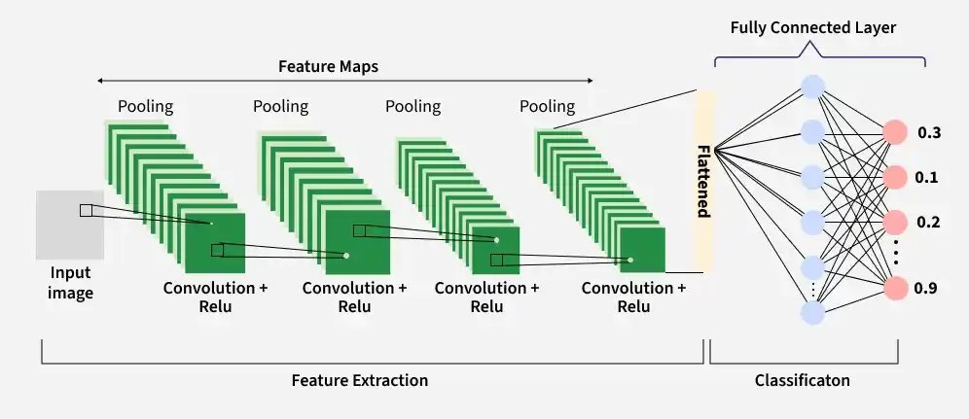
CNN Architecture — Layer by Layer
FEATURE EXTRACTION
CLASSIFICATION
1
2
3
4
5
6
Input Image
Conv + ReLU
Pooling
Feature Maps
Flattened
FC + Output
Raw image — pixel values
0–255 per channel
RGB = 3 channels
Filter slides across image
Detects edges & shapes
ReLU removes negatives
Max Pooling shrinks size
Keeps strongest features
Reduces computation
Multiple Conv+Pool rounds
Each learns more
complex features
2D maps → 1D vector
Bridge to FC layer
for classification
Fully connected neurons
Final class scores
0.3, 0.1, 0.2 … 0.9

Slide 82
CNN — Applications
Where Convolutional Networks Are Used Today
Image Classification
Object Detection
Face Recognition
Identifying what is in an image — Google Photos, ImageNet benchmark.
Locating objects in real time — YOLO algorithm, self-driving cars.
iPhone Face ID, Facebook auto-tagging, security systems.
Medical Imaging
Autonomous Vehicles
Document Analysis
Detecting cancer in X-rays and MRI scans — matching radiologist accuracy.
Tesla Autopilot — identifying roads, pedestrians, signs in real time.
OCR — reading handwritten text, license plates, and printed forms.

Slide 83
PART 2 — RNN
Recurrent Neural Network
RNN is designed to process sequential data — where order and context matter — by maintaining a hidden state that acts as memory across time steps.
The Problem CNN Cannot Solve
'The bank of the river was steep.'
What does 'bank' mean? You need CONTEXT from previous words.
CNN processes each input independently — no memory. RNN solves this by remembering previous context through its hidden state.

Slide 84
RNN Architecture — Unfolding Through Time
The Recurrent Connection and Hidden State Memory
y(t−1)
y(t)
y(t+1)
Legend
x(t) = Input
y(t) = Output
RNN
RNN
RNN
h(t−1)
h(t)
h(t) = Hidden state
→
→
x(t−1)
x(t)
x(t+1)
RNN CONFIGURATIONS
One-to-Many
Many-to-One
Many-to-Many
Bidirectional
One input → sequence
Image Captioning
Sequence → single output
Sentiment Analysis
Sequence → sequence
Machine Translation
Forward + Backward
Context both ways

Slide 85
RNN — Applications
Powering the Language-Based AI You Use Every Day
Machine Translation
Speech Recognition
Sentiment Analysis
Google Translate — converting full sentences between languages by understanding complete context.
Siri, Alexa, Google Assistant — converting spoken audio sequences into text.
Classifying text as positive/negative/neutral — product reviews, social media monitoring.
Text Generation
Time Series Prediction
Music Generation
Auto-completing sentences, chatbots — processing and generating language word by word.
Stock price forecasting, weather prediction — learning patterns in numerical sequences over time.
Composing music note by note — understanding and continuing musical sequences.

Slide 86
PART 3 — GAN
Generative Adversarial Network
GAN consists of two neural networks — a Generator and a Discriminator — trained simultaneously through adversarial competition to generate new, realistic data. Introduced by Ian Goodfellow in 2014.
The Art Forger Analogy
A forger creates fake paintings. A detective identifies fakes. The forger improves to fool the detective. The detective improves to catch better fakes. This competition continues until the forger's work is indistinguishable from real masterpieces.
Generator = Forger. Discriminator = Detective. This competition is how GAN learns.
GENERATOR — The Forger
DISCRIMINATOR — The Detective
Input: Random noise (z vector)
Goal: Generate fake data realistic enough to fool the Discriminator
Learning: Improves every time Discriminator detects its fakes
Output: Fake images / data
Input: Real images (from dataset) + Fake images (from Generator)
Goal: Correctly classify — Real (1) or Fake (0)
Learning: Improves every time Generator fools it
Output: Probability 0 (fake) to 1 (real)
VS

Slide 87
GAN Training Process
How Generator and Discriminator Learn Through Competition
1
2
3
→
→
Train Discriminator
Train Generator
Repeat Adversarially
Show real images → output 1 (Real)
Show Generator's fakes → output 0 (Fake)
Update Discriminator to improve detection.
Generate fake images — pass through Discriminator
If caught (output=0) → Generator failed
Update Generator to fool Discriminator into outputting 1.
This cycle continues thousands of iterations.
Generator improves → Discriminator improves → Generator improves again.
Eventually reaches Nash Equilibrium.

Slide 88
GAN Applications
REAL-WORLD APPLICATIONS
Image Generation
Data Augmentation
Medical Imaging
Creating photorealistic images of people, places, and objects that do not exist.
Generating synthetic training data when real data is limited or privacy-sensitive.
Synthetic medical scans for training AI diagnostics without real patient data.
Drug Discovery
Image Enhancement
Fashion & Design
Generating novel molecular structures — accelerating pharmaceutical research.
Super-resolution — enhancing low-quality images to high resolution.
Generating new clothing designs, interior concepts, and product visuals.

Slide 89
CNN vs RNN vs GAN — Full Comparison
Side-by-Side Reference of All Three Architectures
Feature
CNN
RNN
GAN
Primary Input
Images / Grids
Sequences / Time Series
Random Noise
Primary Output
Classification / Detection
Sequence Prediction
Generated Data
Key Mechanism
Convolution + Pooling
Recurrent state + Gates
Adversarial Competition
Has Memory?
No — spatial only
Yes — hidden state
No sequential memory
Best Problem Type
Spatial / Visual data
Temporal / Sequential data
Data Generation
Training Stability
Relatively stable
Vanishing gradient issue
Notoriously unstable
Key Challenge
Computational cost
Long-term dependencies
Mode collapse
Famous Use
Face ID, Tesla Autopilot
Google Translate, Siri
Deepfakes, StyleGAN

Slide 90
How They Work Together
Combining Architectures for More Powerful AI Systems
CNN + RNN — Image Captioning
Image
CNN
Extract visual
features
Feature
Vector
RNN
Generate
sentence
Caption:
'A dog running
in a park'
→
→
→
→
CNN processes the image → extracts a rich feature vector. RNN takes that vector and generates a descriptive sentence word by word. Used in Google Photos alt-text, accessibility tools, and social media auto-captioning.
CNN + GAN — High Quality Image Generation
Random
Noise
Generator
(CNN-based)
Upsample
Fake
Image
Discriminator
(CNN-based)
Classify
Real or
Fake?
→
→
→
→
DCGAN uses convolutional layers in both networks. Transposed convolutions in Generator upsample noise into images. Standard CNN in Discriminator classifies real vs fake. Using CNNs made GAN training dramatically more stable and higher quality.

Slide 91
Summary
CNN
RNN
GAN
The Eyes of AI
The Memory of AI
The Imagination of AI
Designed for spatial data — images and grids
Convolution detects features — edges → shapes → objects
Powers computer vision applications worldwide
Designed for sequential data — text, speech, time
Hidden state carries context across time steps
LSTM and GRU solve vanishing gradient problem
Two competing networks — Generator vs Discriminator
Adversarial training produces realistic synthetic data
Powers generative AI — art, deepfakes, drug discovery
"CNN gave machines the ability to see. RNN gave them the ability to understand language. GAN gave them the ability to create. These three architectures are the foundation on which the future of AI is being built."
CNN · Convolutional Neural Network RNN · Recurrent Neural Network GAN · Generative Adversarial Network

